Slide 1
Web Content Management
Peer2Peer
Spring 2015
Anthony DeLorenzo
Kim Standifer
Brandon Vega

Slide 2
Agenda
Service Overview
Where we are now
Future Improvements
Statistics
What is to come
Q&A

Slide 3
Service Overview
TERMINALFOUR Site Manager: manage web publishing for public facing web sites.
Centrally managed
Centrally supported
No licensing fees
Non-technical user-friendly
FREE basic hosting
BYOS (bring your own server)
Training provided
Notes:
WCM selection committee to find a campus wide solution to manage
Committees comprised of representatives from many areas of campus
Security – Shib appeared easier to implement; Architecture was

Slide 4
Where we are now…
Refinements to onboarding process
Revision to e-Learning training
Reduction of touch points
Becoming more proactive
Working closely with T4 on improvements

Slide 5
Future Improvements
Role Granularity
Publish times
Auto-migration
Forms

Slide 6
T4 Stats
Total Enrolled in WCM
End Users – 187
Technical Users – 157
Number of sites being setup – 65
Early adaptors
UFIT – 11 sites
Provost – 3 sites
IFAS – 2 sites

Slide 7
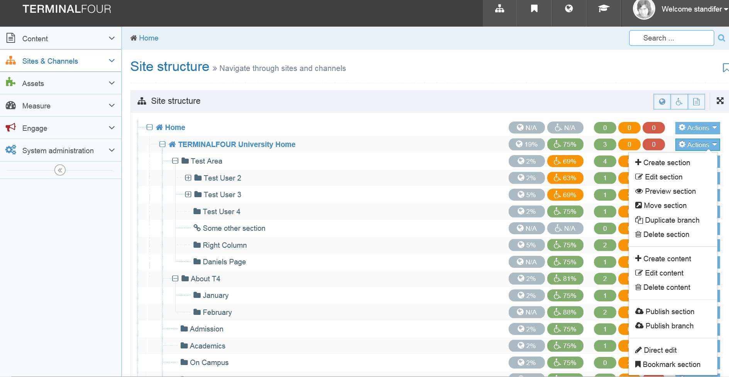
What is to come…
Site Manager version 8
Channel
Section
Notes:
162.209.78.105/terminalfour/

Slide 8
What is to come
V8 training online
Onboarding automation
New UF web design
T4 face to face workshops

Slide 9
Q&A
What concerns do you have?
What can we do to help?

Slide 10
Feedback
UFIT Web Services
http://webservices.it.ufl.edu/

