Slide 1
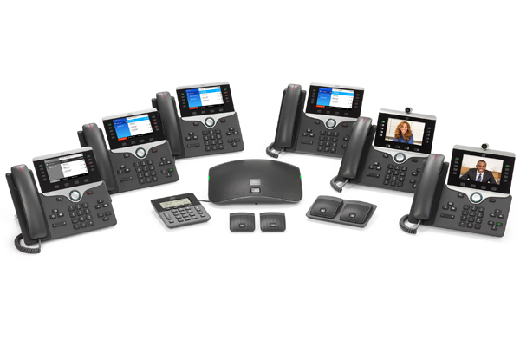
Cisco 8800 Series IP Phone Training

Slide 2
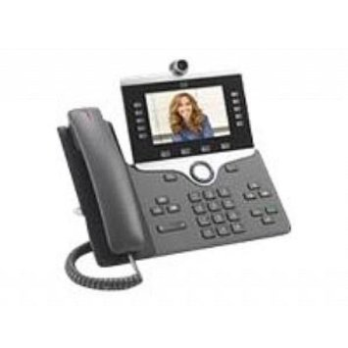
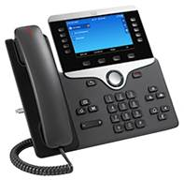
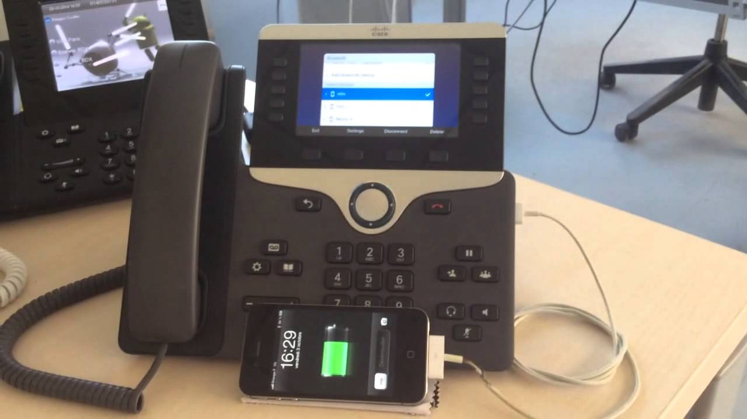
Cisco 8811, 8845, 8851, 8861, 8865
10 Button Phone with USB ports
Only 5 buttons are Programmable - may be configured as combination of Lines, Speed Dials, Busy LampFields or Call Pickups
Up to 5 lines
Remaining 5 buttons are used as session buttons
Models 8845 & 8865 are equipped with camera on top of phone

Slide 3
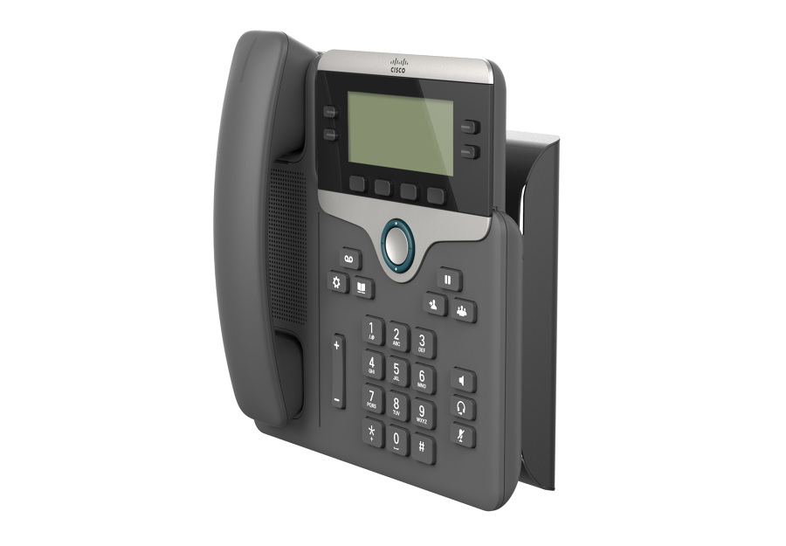
Cisco 8800 Series – Wall Mounted
(Cisco 8811 Shown)
    Phones can be wall mounted
    Wall Mount Kit has an additional charge

Slide 4
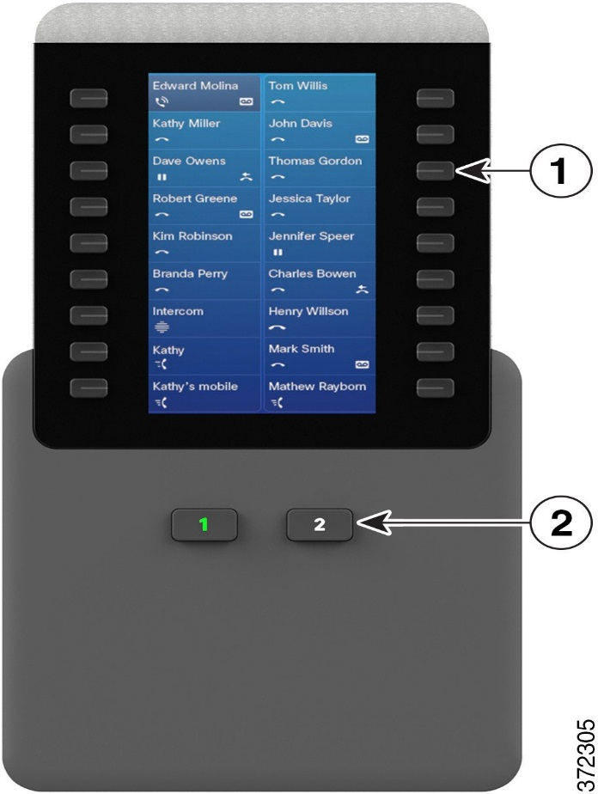
Cisco 8800 Expansion Module
2 Page module –18 programmable buttons per page
Buttons may be configured as combination of Lines,
Speed Dials, Speed Dial Busy
LampFields or Call Pickups
Up to 36 total buttons

Slide 5
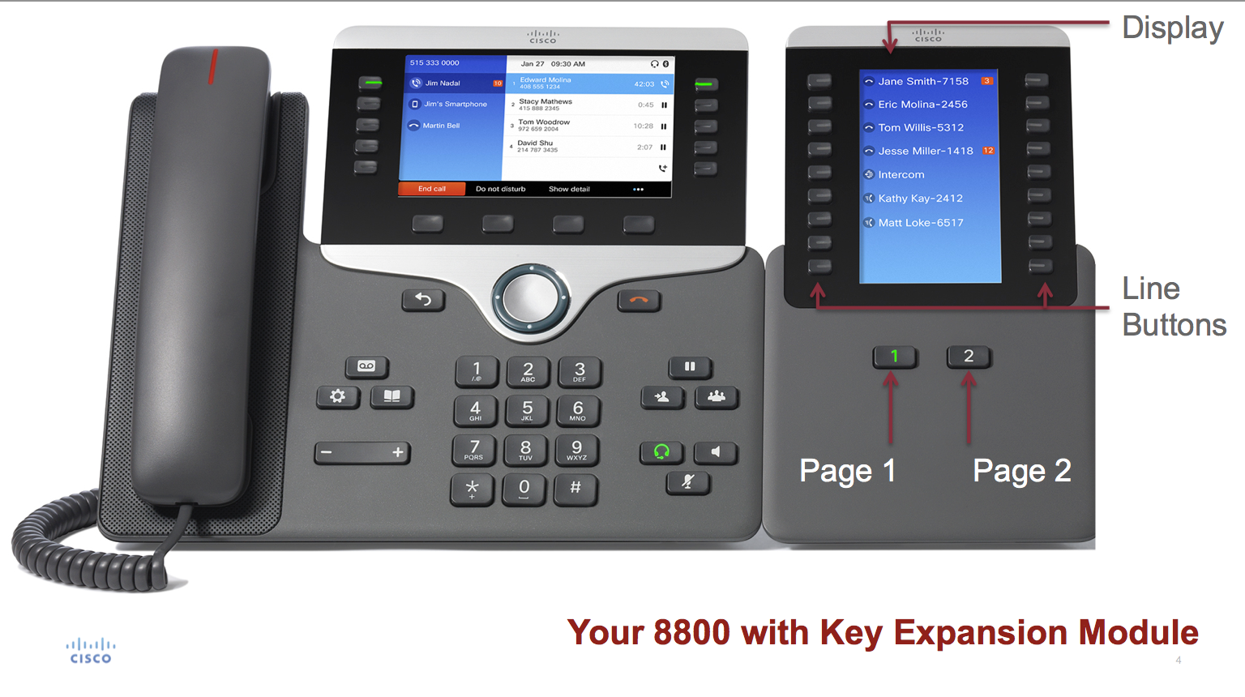
Cisco 8851
8851 model can accommodate 1 - 2 Expansion Modules
Totaling either 36 or 72 extra programmable buttons

Slide 6
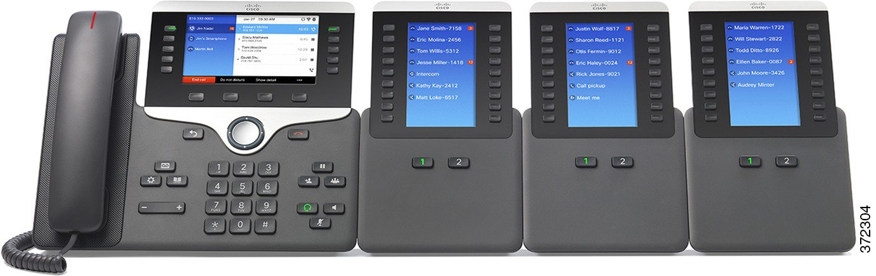
Cisco 8861 or 8865
8861 WI-FI Model
8865 HD Video capabilities
Both models can accommodate up to 3 Expansion Modules
Totaling 108 extra programmable buttons

Slide 7
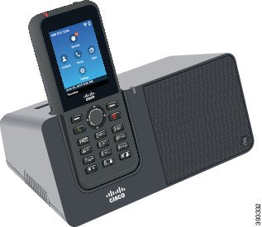
Cisco 8821 Wireless Phone
Supports 2 or more lines – 2.4 inch color display
Bluetooth 4.0 Support
Long Battery life – 240 hours standby or 13 hours talk time
Built in Speakerphone

Slide 8
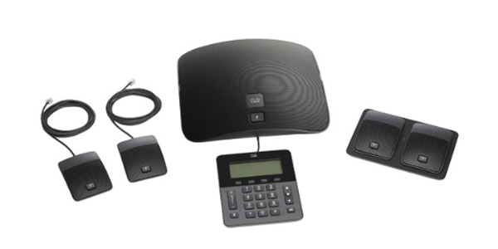
Cisco 8831 Conference Phone
Includes Display Unit & Sound Base with Microphones
Extra microphone kits can be wired or wireless

Slide 9
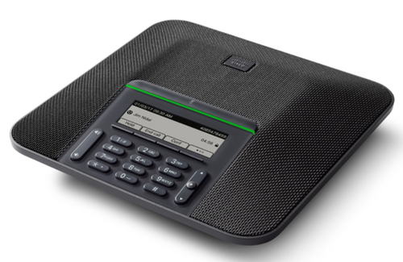
Cisco 8832 Conference Phone
Wideband (G.722) for crystal-clear audio performance
360-degree coverage or rooms up to 800 square feet (74.3 square meters)
Up to 26 attendees
Backlit, antiglare, color pixel display eases viewing and navigation

Slide 10
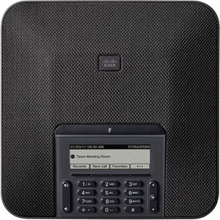
Cisco 7832 Conference Phone
360-degree room coverage for spaces up to 172 square feet (16 square meters)
Microphone pickup up to 7 feet (213 centimeters) from the endpoint
Generous mute button to aid access from all sides of the endpoint
Raised edge to ease handling and repositioning at the table or desk
3.4-inch (8.6-cm) backlit, monochrome, pixel-based display with an antiglare bezel to make viewing and interaction easier

Slide 11

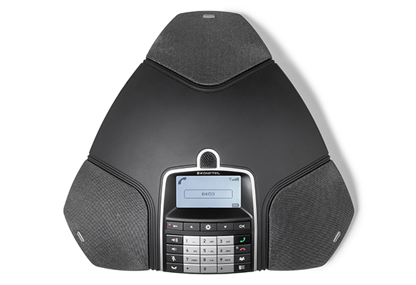
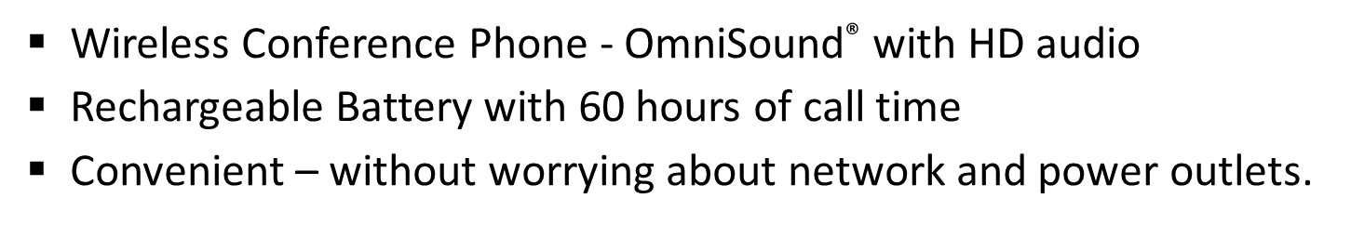

Slide 12
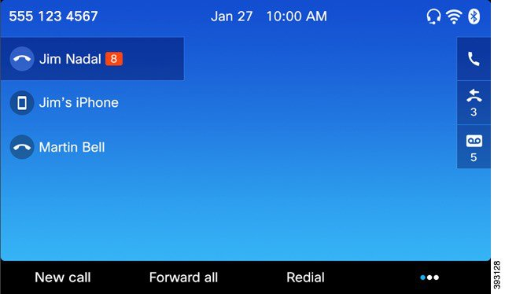
LCD DISPLAY
Displays line appearances, speed dials or busy lamps
Provides date, time, calling party number and/or name on incoming calls & shows number dialed on outgoing calls
Soft keys for added features
Icons on soft keys showing call status

Slide 13







Phone Features & Buttons
LIGHT ON HANDSET - Indicates message waiting and flashes when a call is incoming
NAVAGATION PAD/SELECT BUTTON
    Scrolls between calls
    Scrolls Through Contacts & Applications
VOLUME BUTTON
    Controls ringer & incoming caller (auto save)
    Silences the ringer on an incoming call (press left side once)
HEADSET – Built-in headset port (back of phone) – Headset Button
MUTE - Only “mutes” your side of call (you can still hear caller)‏
SPEAKER – Toggles speakerphone on/off
Note: When Speaker & Mute are on the buttons light up

Slide 14







Additional Phone Buttons
Hold/Resume – Places active call on hold – Resumes a held call
Programmable Feature Button
Lines appearances, Speed Dials, Busy Lamp Fields, Call Pickups
Color Indicators - Green/Steady - Active Call- Green/Flashing - Call on Hold
Red/Steady – Line in use – Red/Flashing – Remote Line on Hold
Amber/Steady - DND active or logged in Hunt Group – Amber/Flashing - Incoming Call
Conference – Use to Create a conference call
Transfer - Use to transfer a call
Release Button – Ends a connected call or session
Back Button – Returns to previous screen or menu
Softkey - Enabled SoftKey options shows up as icons on screen

Slide 15

Feature Keys
Messages – Direct access to voice mail
Contacts – Opens/Closes the Directories/Contacts Menu
    IPhone Directory – Directory consists of UF users of Cisco Phones
    who have Unity Voicemail
    NOTE: Calls can be placed/redialed from directories menu
    Personal Directory – Directory consists of entries created in a Personal
    Address Book to create Fast Dials

Slide 16



Feature Keys
Applications – Opens/closes Applications Menu
Allows access to the following:
  Recents (Call History) – Received Calls Placed Calls Missed Calls
  Settings- Allows you to set personal preferences for your phone
    1. Wallpaper - Set or change Wallpaper (background for phone display)
    2. Ringtone - Set or change Ringtone
    3. Brightness - Set or change Brightness on display (darken/lighten)
    4. Font Size - Set or change Font Size on phone display
    5. Phone Name – Displays model number
    6. Call Notification
    7. Headset Sidetone - Adjust volume of headset
    8. Merge Alert
  Bluetooth
  Accessories
  Running Applications
  Admin Settings
  Phone Information

Slide 17
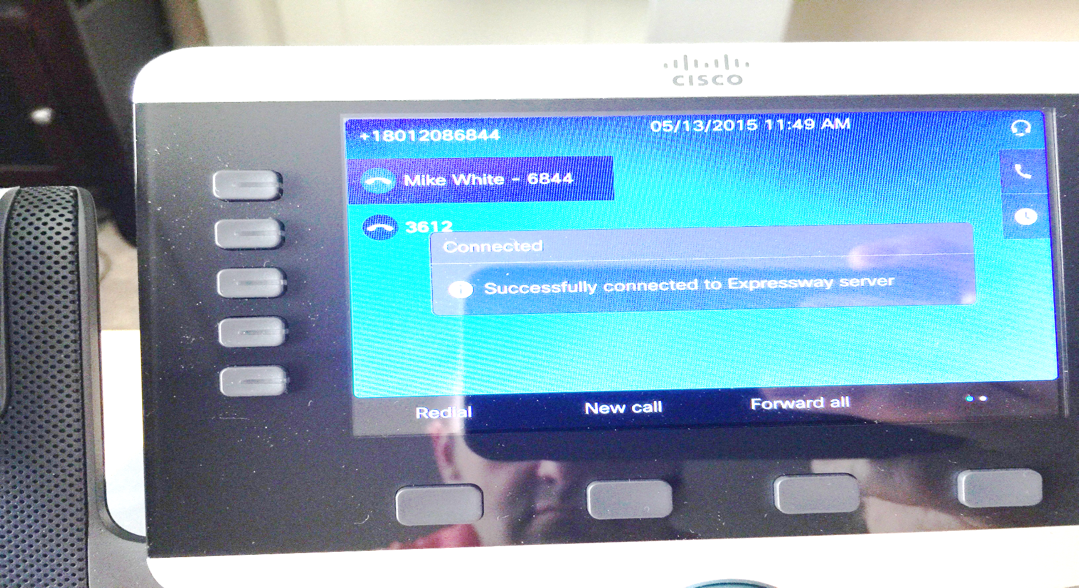
Soft Keys
Four soft keys that guide users through call features & functions
On screen display changes based on operation you are doing
Soft Keys configuration may differ depending on what is programmed on user’s phone

Slide 18
On Hook – Soft keys
Redial New Call Forward All Blank
  Redial– Dials the last number dialed from phone
  New Call – Press to get dial tone
  Forward All – Use to forward your line
    With phone on hook:
    Press key
    Dial number to which you want phone forwarded (display will show ‘To XXXXX’)
    To remove, press Forward Off once

Slide 19
Off Hook- Softkeys
FIRST SCREEN
Redial Cancel Forward All … (more) (Goes to 2nd Screen)
SECOND SCREEN
Pick Up Group Pick Up Meet Me … (more) (Goes to 1st Screen)
Note … (more) - (on 2nd screen takes you to ABC – Call History
If you Toggle through history Softkeys change to Cancel & Call)‏

Slide 20
On A Call - Softkeys
FIRST SCREEN
Hold End Call Transfer … (more) (Goes to 2nd Screen)
SECOND SCREEN
Park Conf Show Detail … (more) – (Goes to 1st Screen)
On Hold – Softkeys
Resume New Call Blank Blank

Slide 21
PHONE SCREEN ICONS
ll Call on hold/Resume Call Placed Calls
Off –Hook Incoming Call
On- Hook Missed Call
Connected Call Received Call
Shared lines in Use Speed Dial Line

Slide 22

This overview will show how to:
ANSWER A CALL
ANSWER CALL WAITING & SWAP
BETWEEN CALLS
TRANSFER A CALL
CONFERENCE CALLS
MEET-ME CONFERENCE CALLS
CALL PICKUP & GROUP PICKUP
CALL PARK
DISTINCTIVE RING

Slide 23
ANSWER A CALL
There are several ways to answer a call
  Pick up receiver
  Press speaker button
  Press Answer soft key
  If you are using a headset, you must press Answer soft key
  Press blinking line button

Slide 24

ANSWER WHILE ON EXISTING CALL (Toggle)‏
Press the blinking line when you are on a call and another call comes in
No need to put first call on Hold (the phone will do it for you)‏
The call you are on Caller Id shows steady
The call on hold will show the blinking line button beside it
To put the 2nd call on hold - Press the Hold soft key or Hold button
Now you have 2 calls on hold & 2 blinking line buttons
You can toggle between calls with the Select/Navigation Button
Select the call you want back – Press Resume soft key or blinking button
Press EndCall soft key when you want to hang up from the call you’re on
Press Resume soft key to Retrieve the other call or press the
blinking button

Slide 25
CALL TRANSFER
From a connected call, press the Transfer Button
Dial the transfer recipient’s phone number.
Press the Transfer Button again (you do not have to wait for them to answer). The transfer is complete.
Note 1: If you want to announce the call to the recipient before completing the transfer, wait for them to answer BEFORE pressing the Transfer Button the 2nd time.
Note 2: If you decide you don’t want to complete the transfer AFTER you have dialed the recipient, press the End Call Softkey (located under the screen display), THEN press your flashing line button OR press the Resume Softkey (located under the screen display) to speak to the caller again.
Note 3: If you want to transfer directly ito a recipient’s voicemail box press the Transfer Button
Press *(star) and dial the phone number, then quickly press the Transfer Button again so the caller won’t miss the beginning of the recipient’s voicemail greeting.

Slide 26
CONFERENCE CALLS
From a connected call, press the Conference Button ((call will be put on hold, you will hear dial tone & caller on hold will hear music).
Dial the next person; when they answer, press the Conference Button to add them to your conference.
To add more participants, press the Conference Button again and repeat these steps (you can conference a maximum of 6).
The conference call ends when all participants hang up or initiator presses End Call Softkey
To remove a participant from conference, press … more Softkey,
Press Show Details Softkey, Use Select/Navigation Button
to select the person, then press Remove Softkey
(Note: only the initiator can remove a participant)

Slide 27
MEET – ME
CONFERENCE CALLS
Initiator calls participants and provides Meet-Me phone number and time to call in.
It is recommended that initiator forwards their calls to voicemail prior to setting up MeetMe Conference Call to avoid getting an incoming call on private line while conference call is active
To set up conference:
1. Lift handset, press …more Softkey, press MeetMe Softkey
2. Dial the MeetMe phone number – LCD Display will show Conference
3. At the designated time the other participants can now call into
designated telephone number given by the initiator
To end conference – press the EndCall Softkey
Note: Meet-Me Conference can include 16 participants

Slide 28
CALL PICKUP
& GROUP CALL PICKUP
Call PickUp: If your phone is a member of a Call Pickup Group, you can answer someone else’s ringing phone at your desk. Just lift your handset press …more Softkey & press the Pickup Softkey. Your phone will ring. Press Answer Softkey
If Call PickUp is programmed on a button
Press the flashing amber line button Your phone will ring
Press Answer Softkey or flashing amber line button
Group Call Pickup: This feature allows you to answer an incoming call from a phone that is not in a Call Pickup Group. Just lift the handset press …more Softkey, press the GPickup Softkey – You will hear 2 beeps, Dial the phone number of the phone you want to answer, Your phone will ring, press Answer Softkey or flashing amber line button

Slide 29
CALL PARK
This feature allows you to place a call on hold, so it can be retrieved from another phone in the system (for example, a phone in another office or in a conference room).
To use Call Park: If you are on an active call at your phone, you can park
the call on a call park extension by the pressing …more Softkey, then press
Park Softkey.
The LCD display will show the extension # where the call is parked.
You can retrieve the call in another room or someone else on another
phone in your system can then dial the call park extension to retrieve
the call.
The call will stay parked for 2 minutes. If it is not retrieved within that
time frame it will ring back to the phone that parked it.

Slide 30

DISTINCTIVE RING
This feature allows phone to have a different Ringtone if phone has more than one line
To activate:
  Press Applications Button
  Press 2 For Settings
  Press 2 For Ringtone
  Press 1 for Line 1 – Use Select/Navigation Button to scroll through list
  Press Play Softkey to hear how it sounds
  Highlight the one you want – Press Set Softkey, to save it
  Press Exit Softkey to exit out
  Repeat these steps for other lines on your phone

Slide 31
QUESTIONS?
More info:
  https://it.ufl.edu/ict/documentation/telecommunications/
Phone: 352-273-1234
Thanks for your attendance !
  Created by: Rosa Jackson rosaj@ufl.edu
  07/09/2018

