Slide 1
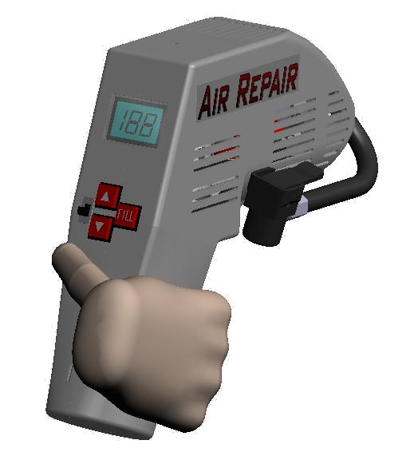
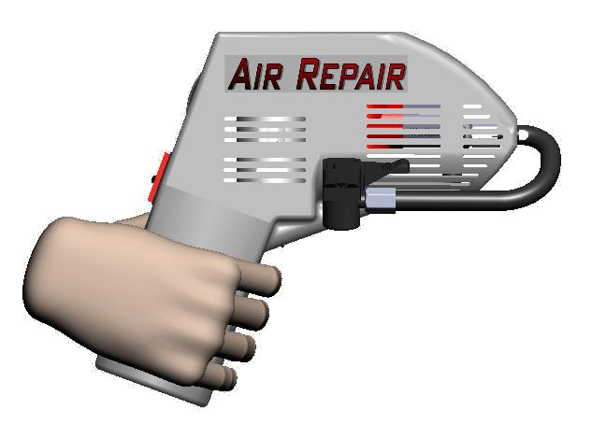
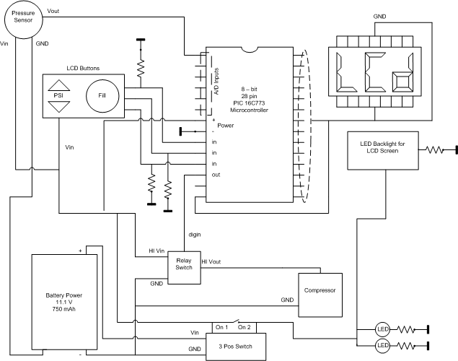
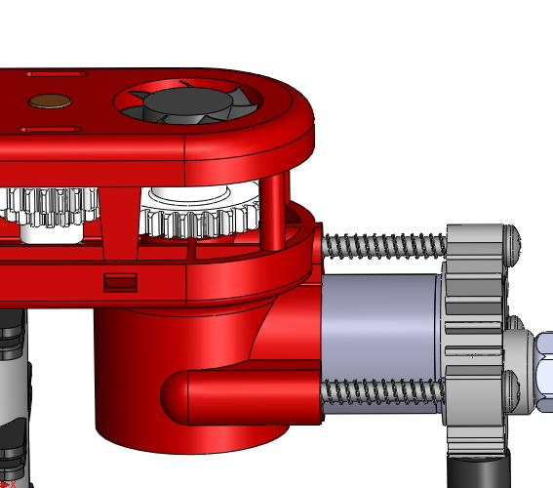
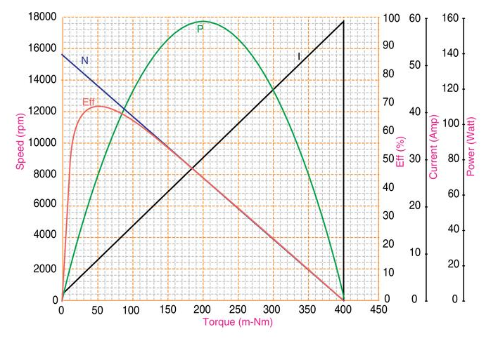
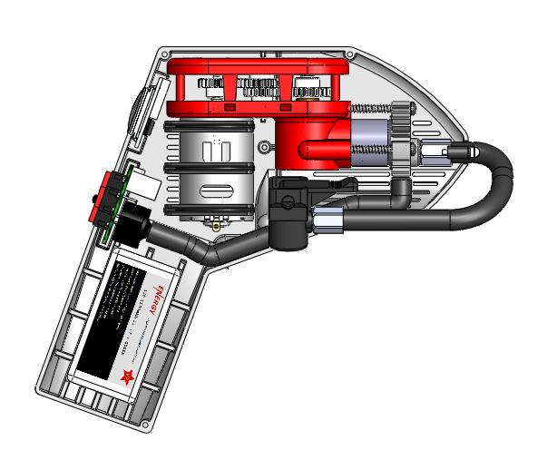
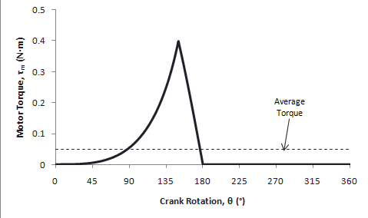
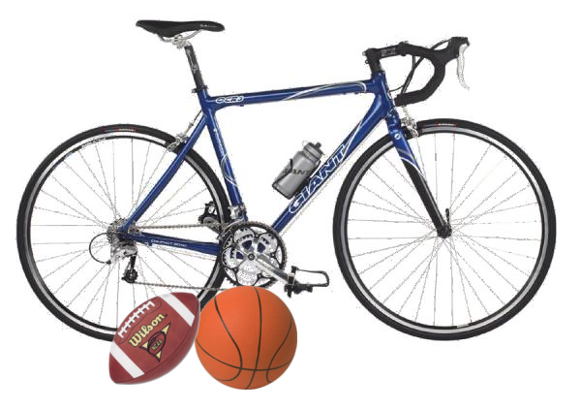
Electrical Circuit
8-Bit, 28 pin microcontroller
Piezoelectric pressure sensor
Two LEDs
Backlit LCD display
Power switch
Relay switch
12 VDC electric motor
11.1 V, 1100 mAh lithium ion
battery
AC adapter
Air Compressor
EML 4501 – Group 5
Department of Mechanical & Aerospace Engineering
Sean Lopez, Hans Roesch, Andrew McDonald, Paul Moore, Daniel Zambrano, Brian Davidson
Materials
Design Features
Compact, lightweight, portable air compressor
Attaches to the top tube of common bicycle frames
Maximum pressure: 120 psig
Fills 3 mountain bike tires with SF = 1.3,
3 road bike tires with SF = 2.7,
8 basketballs or 11 footballs with SF = 1.0
LCD display with automatic shutoff at desired pressure
Rechargeable using 11.1 V, 1100 mAh lithium-polymer battery
To be sold for $80.00
LED lighting for night time use
How It Works
A rechargeable, 11.1 V, 1100 mAh battery powers an electric motor
The motor drives a gear train with a gear ratio of 3.5
The final gear of the gear train rotates the fan, piston crank, and counterweight
The piston crank actuates the piston head in its forward and backward strokes
The fan draws in ambient air from outside the air compressor and blows it over the piston casing
Heat Transfer
Computer-style fan
(Q = 6.5 cfm)
Fin-cooled piston head
(q_{f,total} = 4.38 W, ε_{f} = 2.53)
Strategically placed air vents for
cool air intake and hot air
exhaust
Designed to prevent users from
holding hot sections of the
device
Operation
Bicycle Tires
Remove the Schrader valve cap
Attach the Air Repair nozzle
Set desired pressure by pressing the and buttons
Press the “Fill” button
Sports Balls
Attach needle adapter to Air Repair nozzle
Insert needle into sports ball valve
Set desired pressure by pressing the and buttons
Press the “Fill” button
Manufacturing Cost
Total cost of materials and parts: $34.58
Total assembly time: 5 minutes and 46 seconds
Labor rate: $30.56/hr (manufactured in USA)
Assembly cost: $2.94
Start-up cost from automatic soldering machine: $10,000
Total manufacturing cost: $37.52
Manufactured Parts COTS Parts
Performance
Average torque during
compression is at maximum
motor efficiency
Maximum torque at 150 psig
tire pressure is equal to motor
stall torque
All high cycle fatigue stresses
fell within the modified
Goodman plot areas for
their material types
High discharge battery with
15C allows up to 169.5 Amps
of current
Battery can power the
compressor for 433 seconds
of runtime
Part Number | Part Description | Plastic/ Metal/ Rubber? | Material | Manufacture Cost
1 | Air Hose | R | Styrene-butadiene Rubber | $0.15
2 | Air Hose Connector | M | Aluminum | $0.25
3 | Air Hose Metal Needle | M | Machined Brass | $0.30
4 | Air Hose Nozzle Casing | P | Nylon | $0.17
5 | Air Hose Nozzle Connector | P | Nylon | $0.14
6 | Air Hose Nozzle Lever | P | Nylon | $0.15
7 | Air Hose Nozzle Rubber | R | Styrene-butadiene Rubber | $0.07
8 | Bottom Casing | P | Polypropylene | $0.78
9 | Casing-Gear Bearing | M | Steel Alloy 4140 | $0.25
10 | Counterweight | M | Zinc | $0.32
11 | Counterweight Pin | M | Steel Alloy 4140 | $0.24
12 | Counterweight Rod | M | Steel Alloy 4140 | $0.27
13 | Dual Gear | P | Acetal (Duracon) | $0.12
14 | Fan | P | ABS | $0.16
15 | Gauge Hose | R | Styrene-butadiene Rubber | $0.15
16 | Gear 2 | P | Acetal (Duracon) | $0.09
17 | Gear Axis Shaft | M | Steel Alloy 4140 | $0.25
18 | Gear Train Top Casing | P | Phenol Formaldehyde | $0.30
19 | LCD Cover | P | Polysulfone | $0.18
20 | Motor Casing-Split Lock Washer | M | Steel Alloy 4140 | $0.10
21 | Motor Cushion | R | PVC Elastomer | $0.10
22 | Pinion | M | Acetal (Duracon) | $0.09
23 | Piston Bottom | M | Steel Alloy 4140 | $0.38
24 | Piston Casing | P | Phenol Formaldehyde | $0.40
25 | Piston Connecting Rod | M | Steel Alloy 4140 | $0.50
26 | Piston Cylinder | M | Steel Alloy 4140 | $0.28
27 | Piston Head-Body | M | Zinc | $0.52
28 | Piston Top | M | Steel Alloy 4140 | $0.19
29 | Piston Pin | M | Steel Alloy 4140 | $0.24
30 | Piston Rubber Seal | P | FEP | $0.08
31 | Pressure Seal PCB | R | Styrene-butadiene Rubber | $0.04
32 | Sensor Case Bottom PCB | P | Nylon | $0.14
33 | Sensor Case Top PCB | P | Nylon | $0.13
34 | Upper Casing | P | Polypropylene | $0.78
 |  |  | Total | $8.31
Part Number | Part Description | Part Cost
1 | 3 Step Switch PCB | $0.25
2 | Arrow Button Down PCB | $0.16
3 | Arrow Button PCB | $0.16
4 | Battery Pack | $8.00
5 | Buton Circuit Board | $0.15
6 | Button Harness | $0.05
7 | Charger | $5.71
8 | Fill Button PCB | $0.16
9 | LCD and MC Board | $0.50
10 | LCD Backlight | $0.20
11 | LCD Board Wire Harness | $0.05
12 | LCD PCB | $0.60
13 | LED | $0.10
14 | MC Controller PCB | $0.80
15 | Motor | $2.00
16 | Pressure Sensor PCB | $6.55
17 | Relay PCB | $0.40
18 | Resistors | $0.20
19 | Board Screws | $0.08
20 | Piston Screws | $0.15
 | Total | $26.27
Safety Features
Hot components located away from handle
Automatic shut-off to prevent overfilling tires and balls
LED lighting for night time use
Designed for adequate air flow to prevent overheating

